Slide 1

Marketing Your Business in the Digital Age
Denton Gibbes • President & CEO • The Gibbes Company

Slide 2
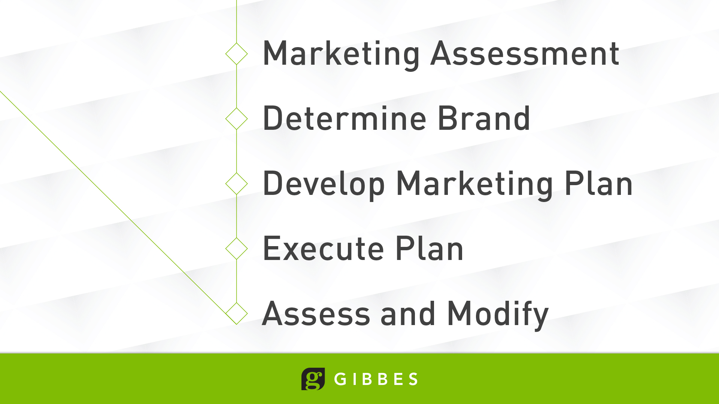
Notes:
What business people tend to forget about social media – usually because their unfamiliarity freaks them out – is that social media is merely another tool in their marketing toolbox.
So before you throw up a Facebook page because everyone else has one, or establish an Instagram or Snapchat account because your teenager says that’s where all the cool folks are – look at your brand and ask yourself:
What business am I in?
Who are my customers?
Where are my customers?
Who or what do I need to influence?
What behaviors do I need to change?
How can my company/business make a difference?
And most importantly - What are my business goals?
Examples – Whole Foods adding tattoo parlors & juice bars, MDOT and STEM Education

Slide 3
Who are your customers?
How do I get my customer’s attention?
What are Market Segments?
How do I set realistic goals for my business?
How do I name my business?
How do I get Feedback on my Business Concept?

Slide 4
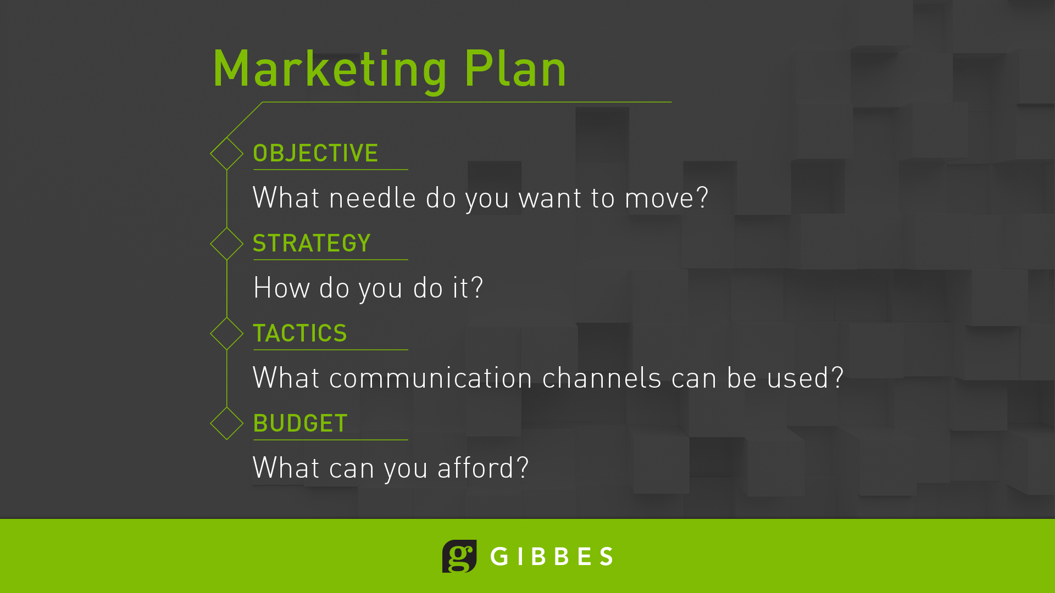
Notes:
Budget is not always in terms of dollars. Also think in terms of personnel investment, time spent

Slide 5
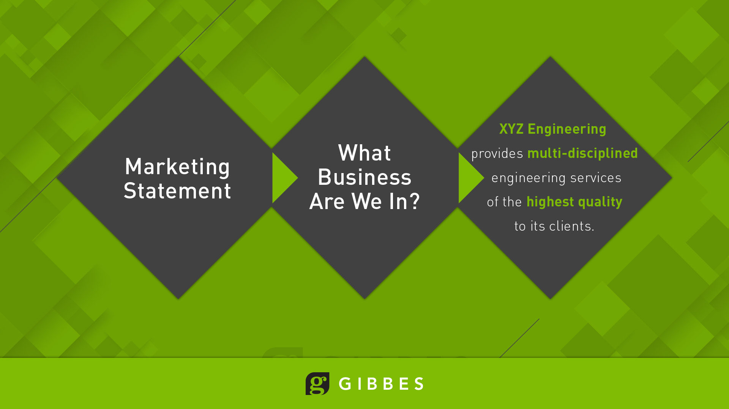

Slide 6
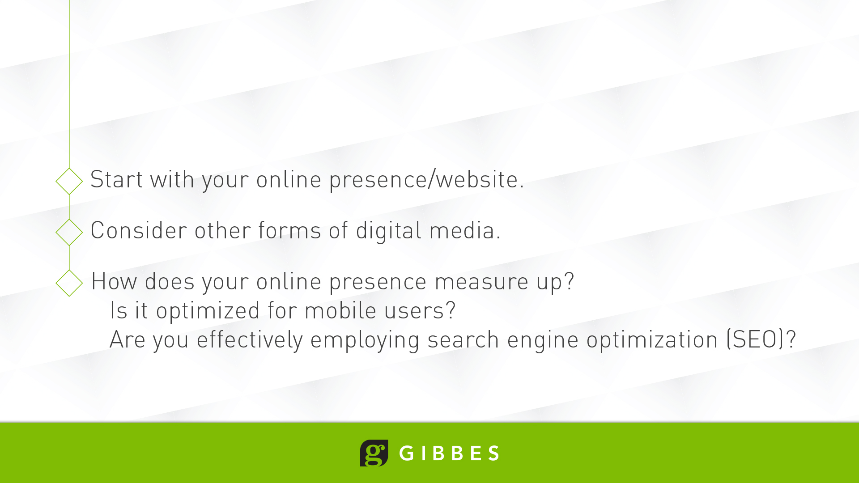

Slide 7
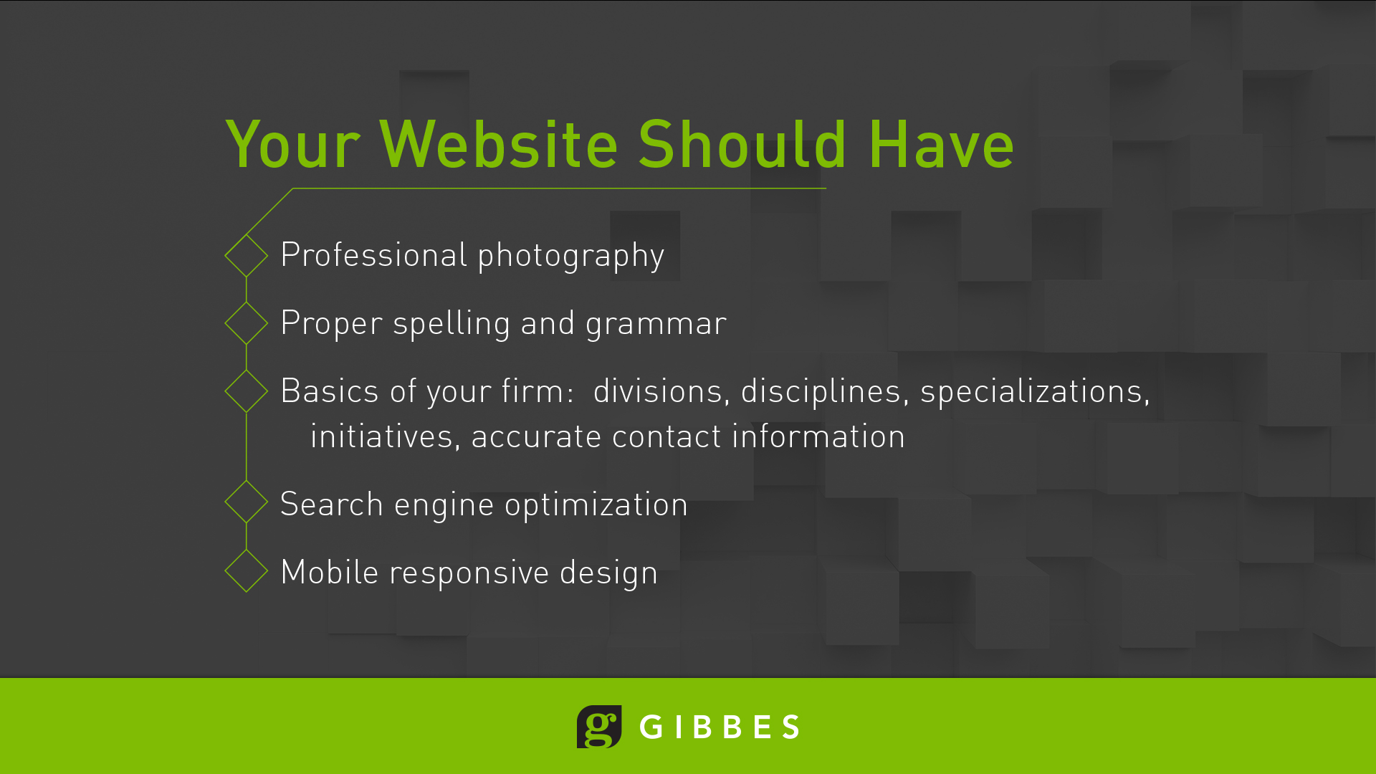

Slide 8
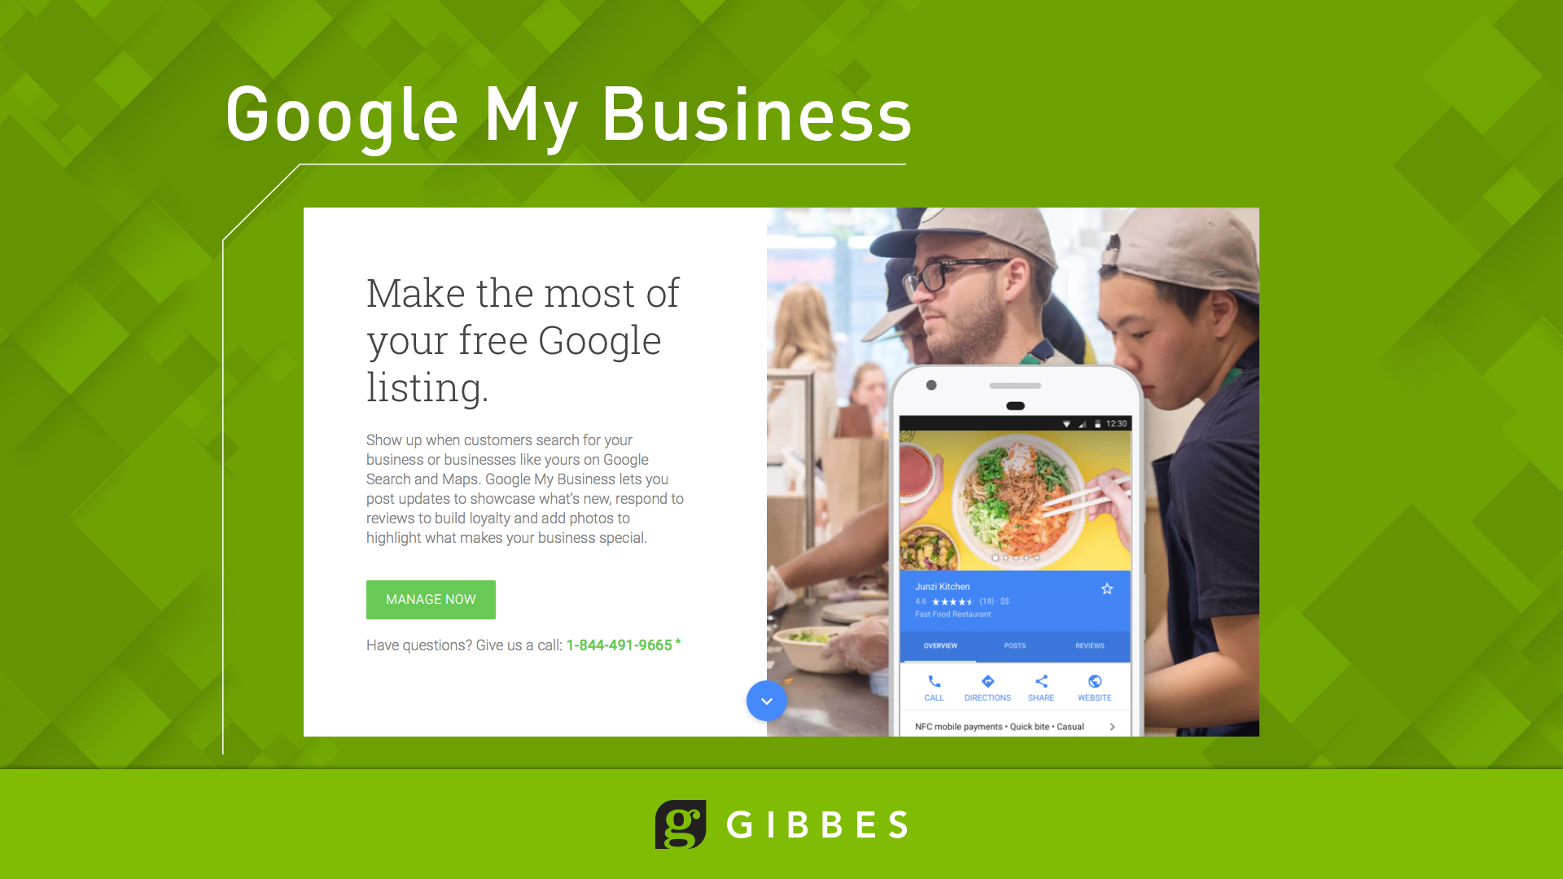

Slide 9
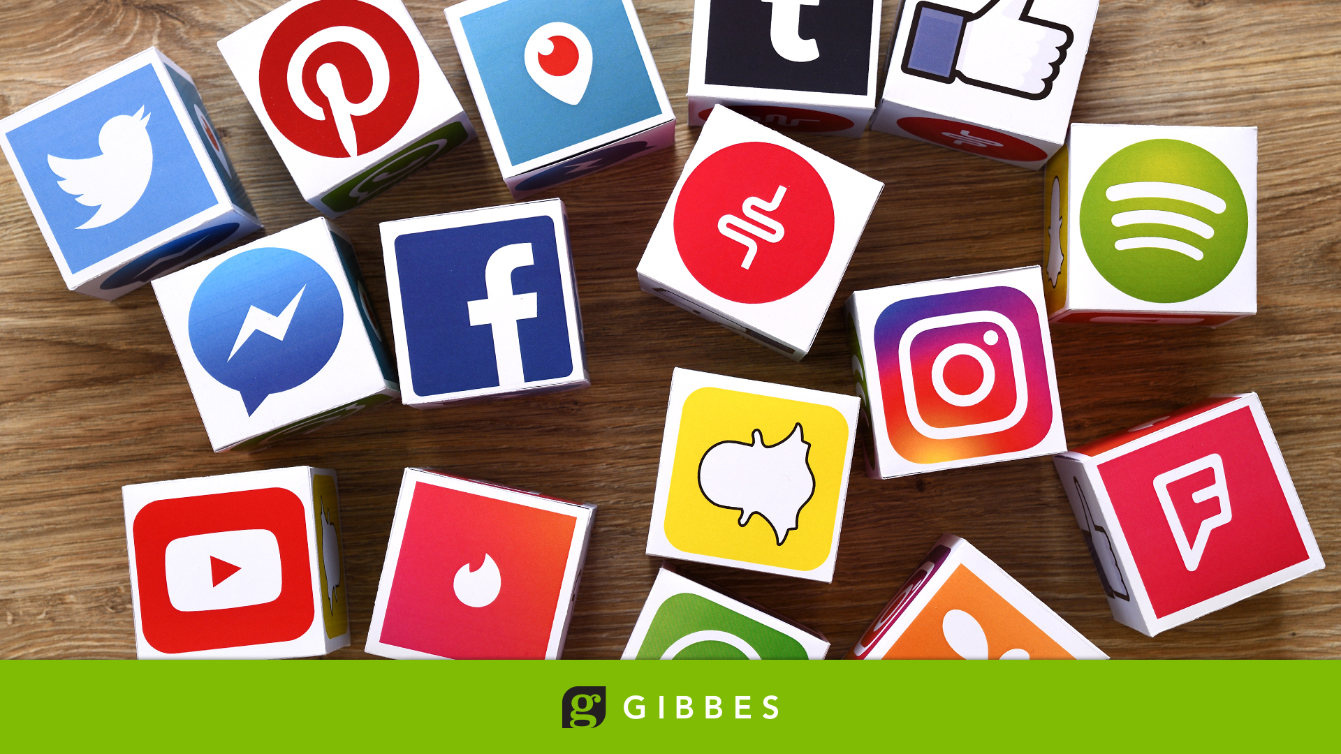
Notes:
After you’ve answered these questions, then take a look at your social media options.
A little overwhelming, don’t you think?
Decide first – where are my customers?
Can’t go wrong with Facebook or Twitter, due to the sheer volume of folks using those applications.
Pinterest – primarily women
Google Plus – skews to older males
Instagram and Snapchat – younger audience
LinkedIn – business audience. Facebook for business folks. Extended stay apartments complexes = excellent marketing opportunity
Vine or Vimeo – videos that attract a high school/college age audience

Slide 10
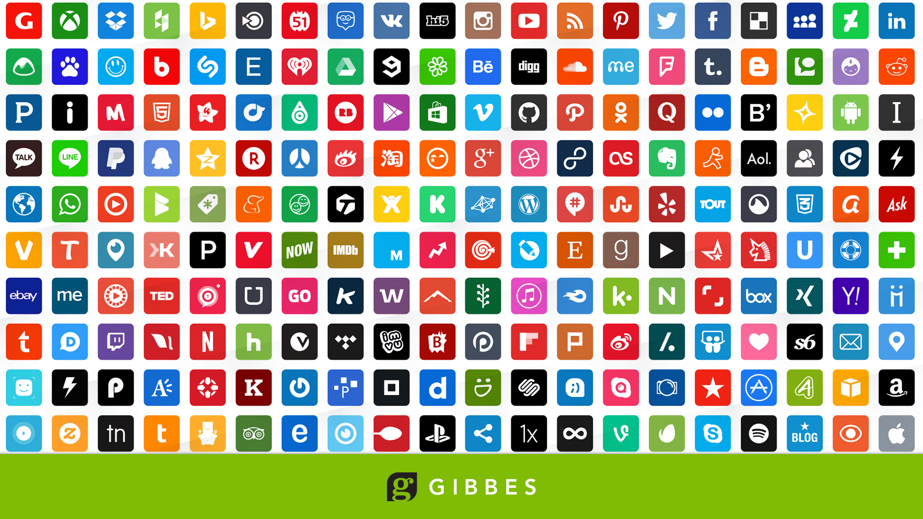
Notes:
If you’re going to have multiple accounts, try and establish same user/account name for each – that establishes consistency and reinforces your brand/company name. Not always possible.
Then be sure that you post links to those applications on your website. And that you have your website link on your social media pages. Everything should cross brand and lead from one to another.
Drives me crazy when I see a Facebook page that doesn’t have the company website or a phone number. Must admit TGC’s page doesn’t have these link – like lawyers an ad agency is often its own worst client.

Slide 11
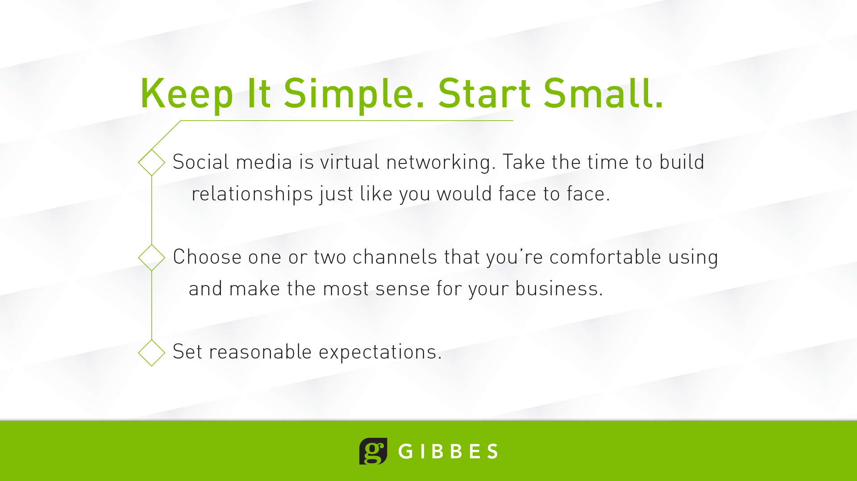

Slide 12
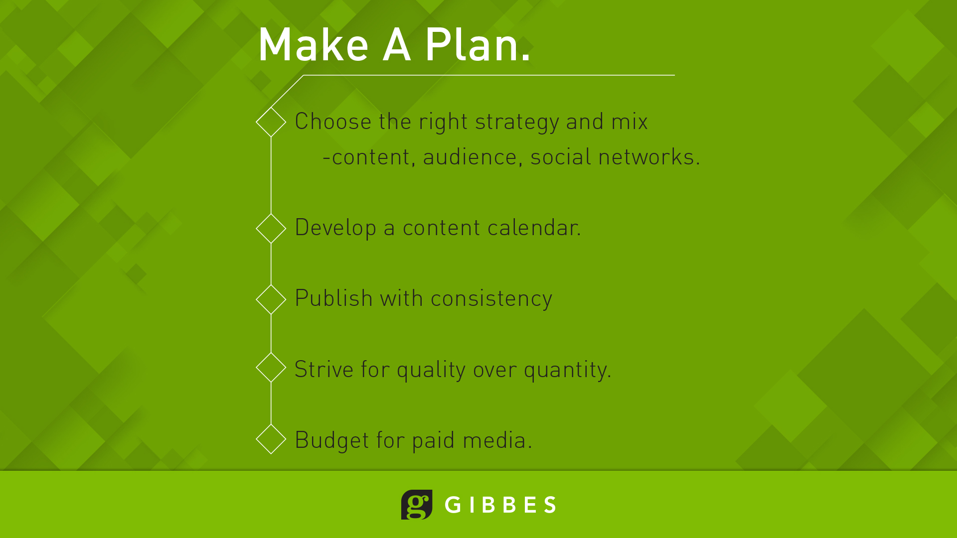

Slide 13
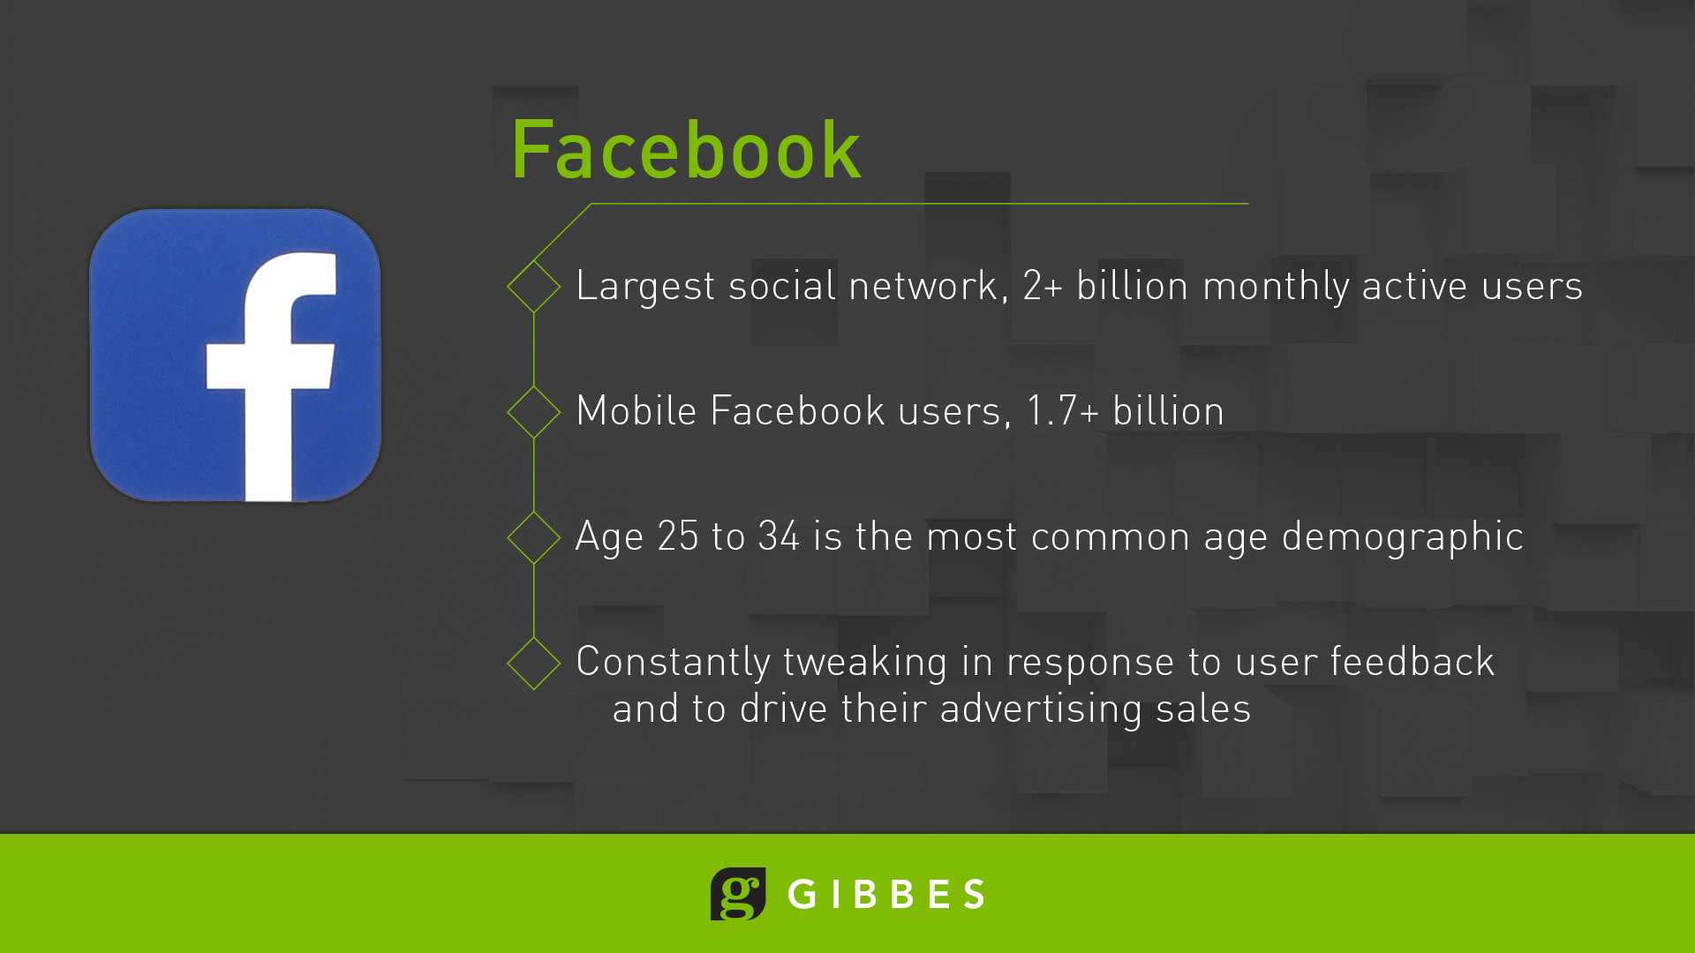
Notes:
Facebook’s numbers mean they’re too big to ignore. Women are slightly more active.
People age 18-29 are most prevalent Facebook users, with 30-49 second highest.
Personally, I believe it’s not just due to user feedback but is designed to drive advertising sales. Used to be one could generate likes easily. Now it’s much more difficult unless one pays for likes or sponsored posts.
Sponsored posts or ads are one way to target your advertising message – by geographic area, interest, level of education, age, gender, etc.
Consider Facebook more of a community, social place. Housing is of interest on Facebook.
More than just likes on a page – it’s the sum total of your interaction – comments, page views, etc. If you’re an administrator for a Facebook page you receive a weekly summary.

Slide 14
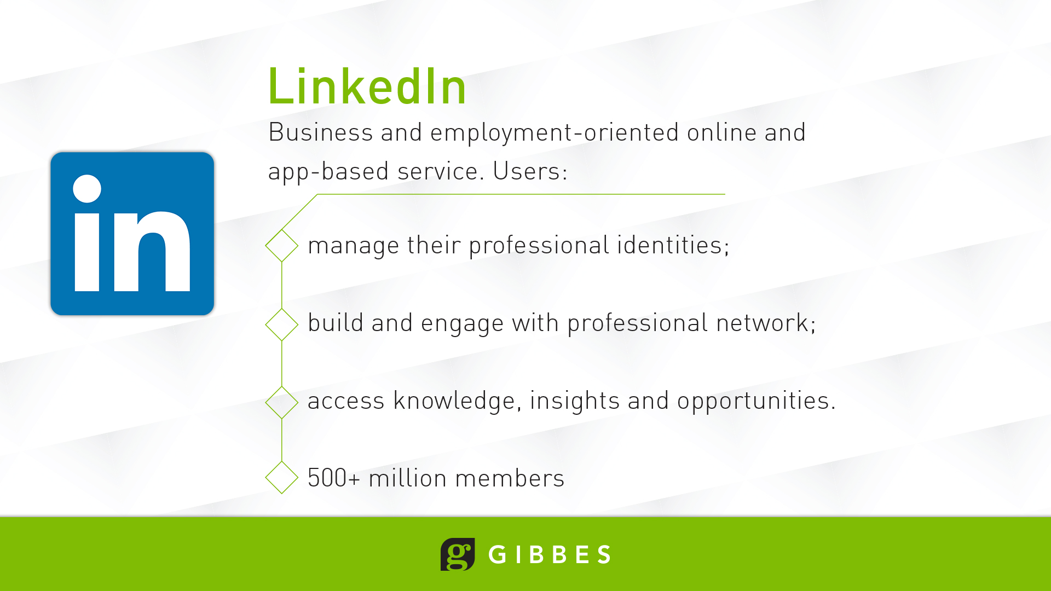
Notes:
I look at Twitter like I do the scrolling news feed at the bottom of my TV.
As with Facebook you have advertising alternatives – sponsored posts, web cards, website conversions, etc. I find Twitter’s advertising support to be more effective, but the end results pale in comparison to Facebook.
Use this more to establish legitimacy, credibility and newsworthiness. News outlets get their stories from Twitter.
As with Facebook, tag interested parties, partners and officials. Generate more views and interest.

Slide 15
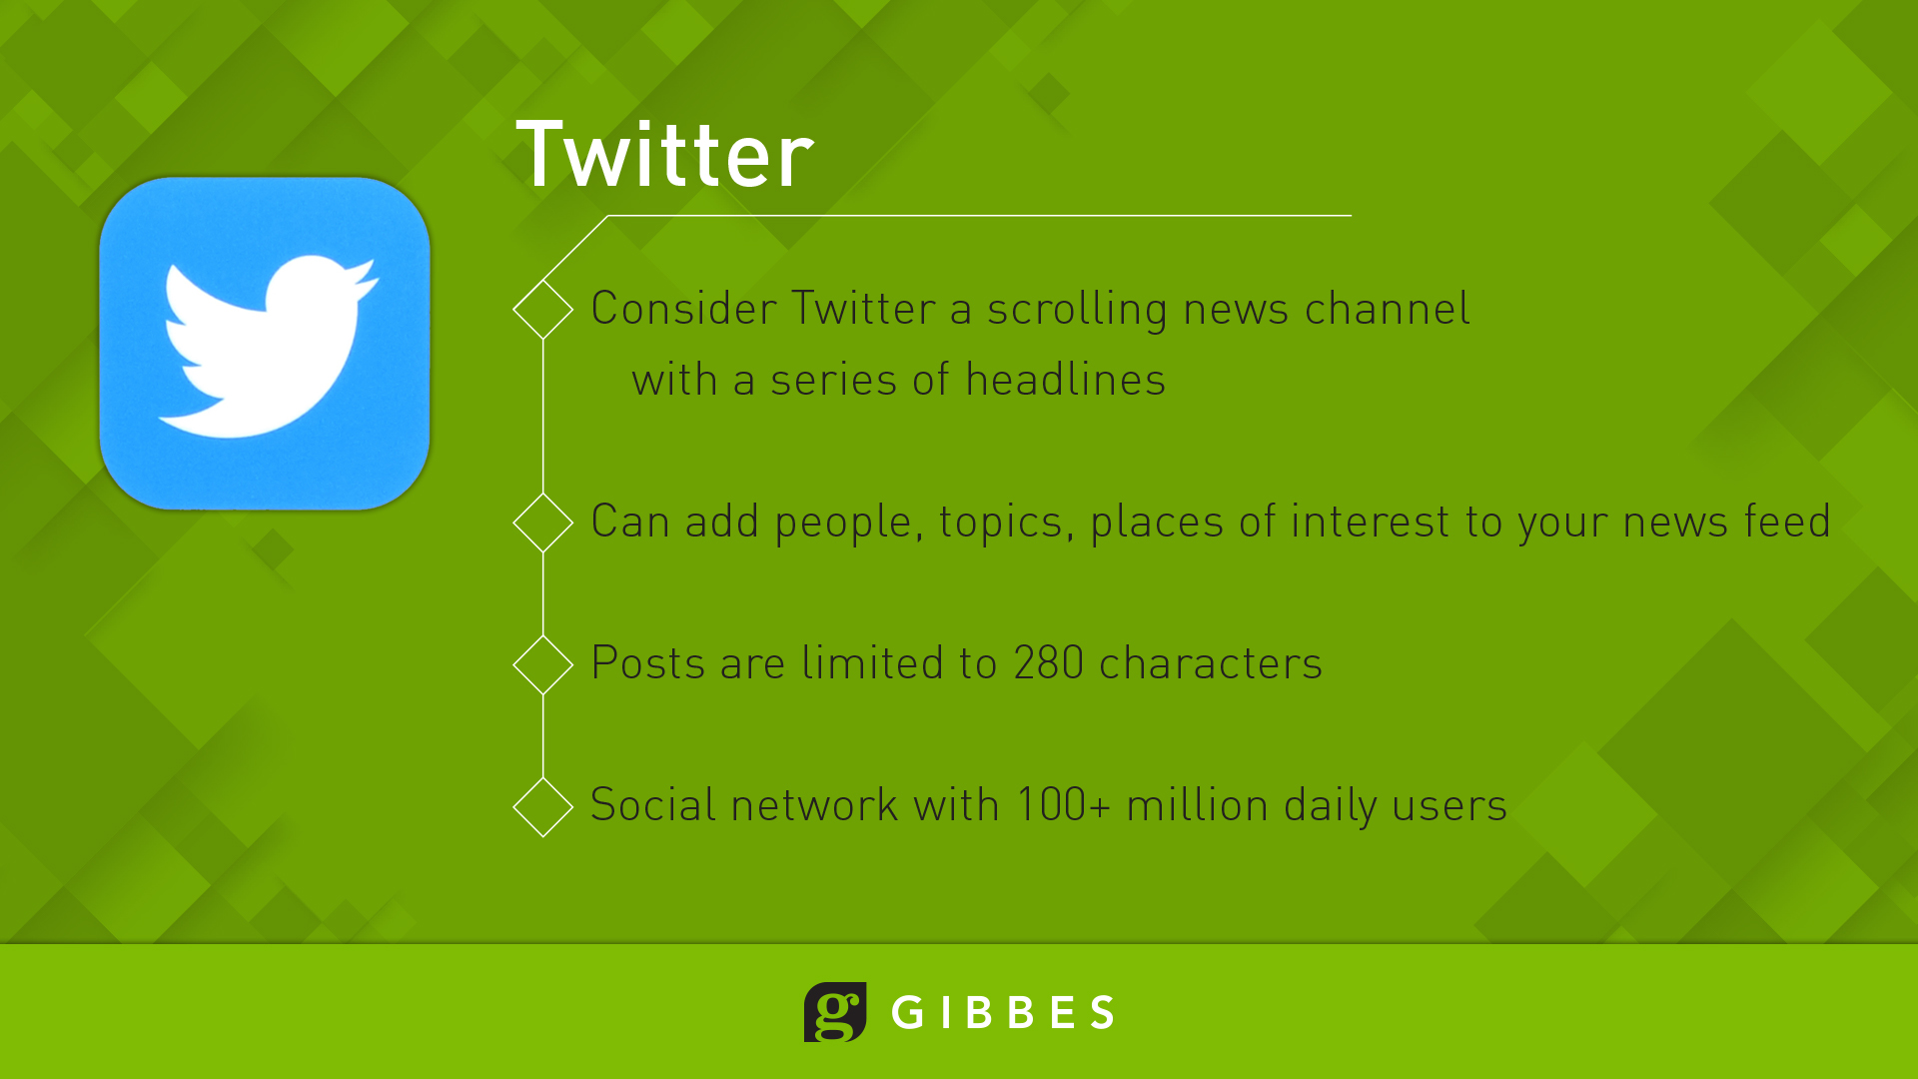
Notes:
I look at Twitter like I do the scrolling news feed at the bottom of my TV.
As with Facebook you have advertising alternatives – sponsored posts, web cards, website conversions, etc. I find Twitter’s advertising support to be more effective, but the end results pale in comparison to Facebook.
Use this more to establish legitimacy, credibility and newsworthiness. News outlets get their stories from Twitter.
As with Facebook, tag interested parties, partners and officials. Generate more views and interest.

Slide 16
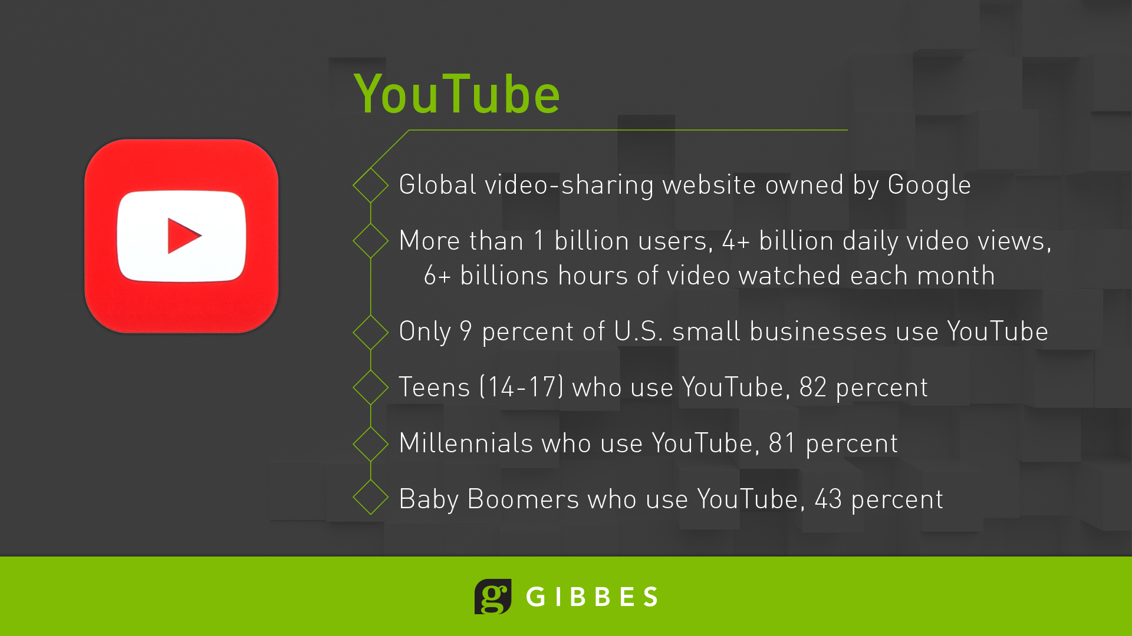
Notes:
While I’m showing the logos for Twitter and Facebook, these tips apply to practically any social media outlet:
Most people skim the Internet until they find something that interests them and decide they want to read more. You want to capture their attention with:
Engaging posts
Posts with photos, videos and other visual content generate more views and shares
Add a number to the post/title – Top 5 Reasons to Live at Valley Park Apartments
Break your content up into small, bite-sized pieces
Keep your sentences short – GIVE IT THE TWITTER TEST – 104 characters
Limit paragraphs to no more than four or five lines and a few sentences each

Slide 17
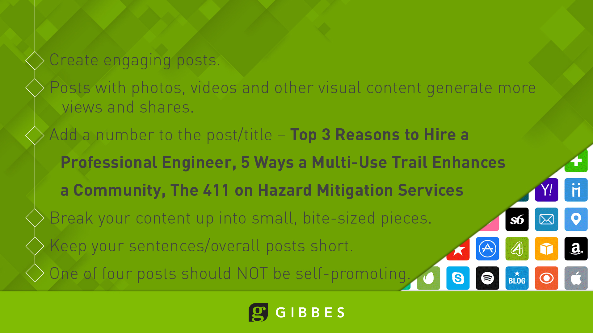
Notes:
I look at Twitter like I do the scrolling news feed at the bottom of my TV.
As with Facebook you have advertising alternatives – sponsored posts, web cards, website conversions, etc. I find Twitter’s advertising support to be more effective, but the end results pale in comparison to Facebook.
Use this more to establish legitimacy, credibility and newsworthiness. News outlets get their stories from Twitter.
As with Facebook, tag interested parties, partners and officials. Generate more views and interest.

Slide 18
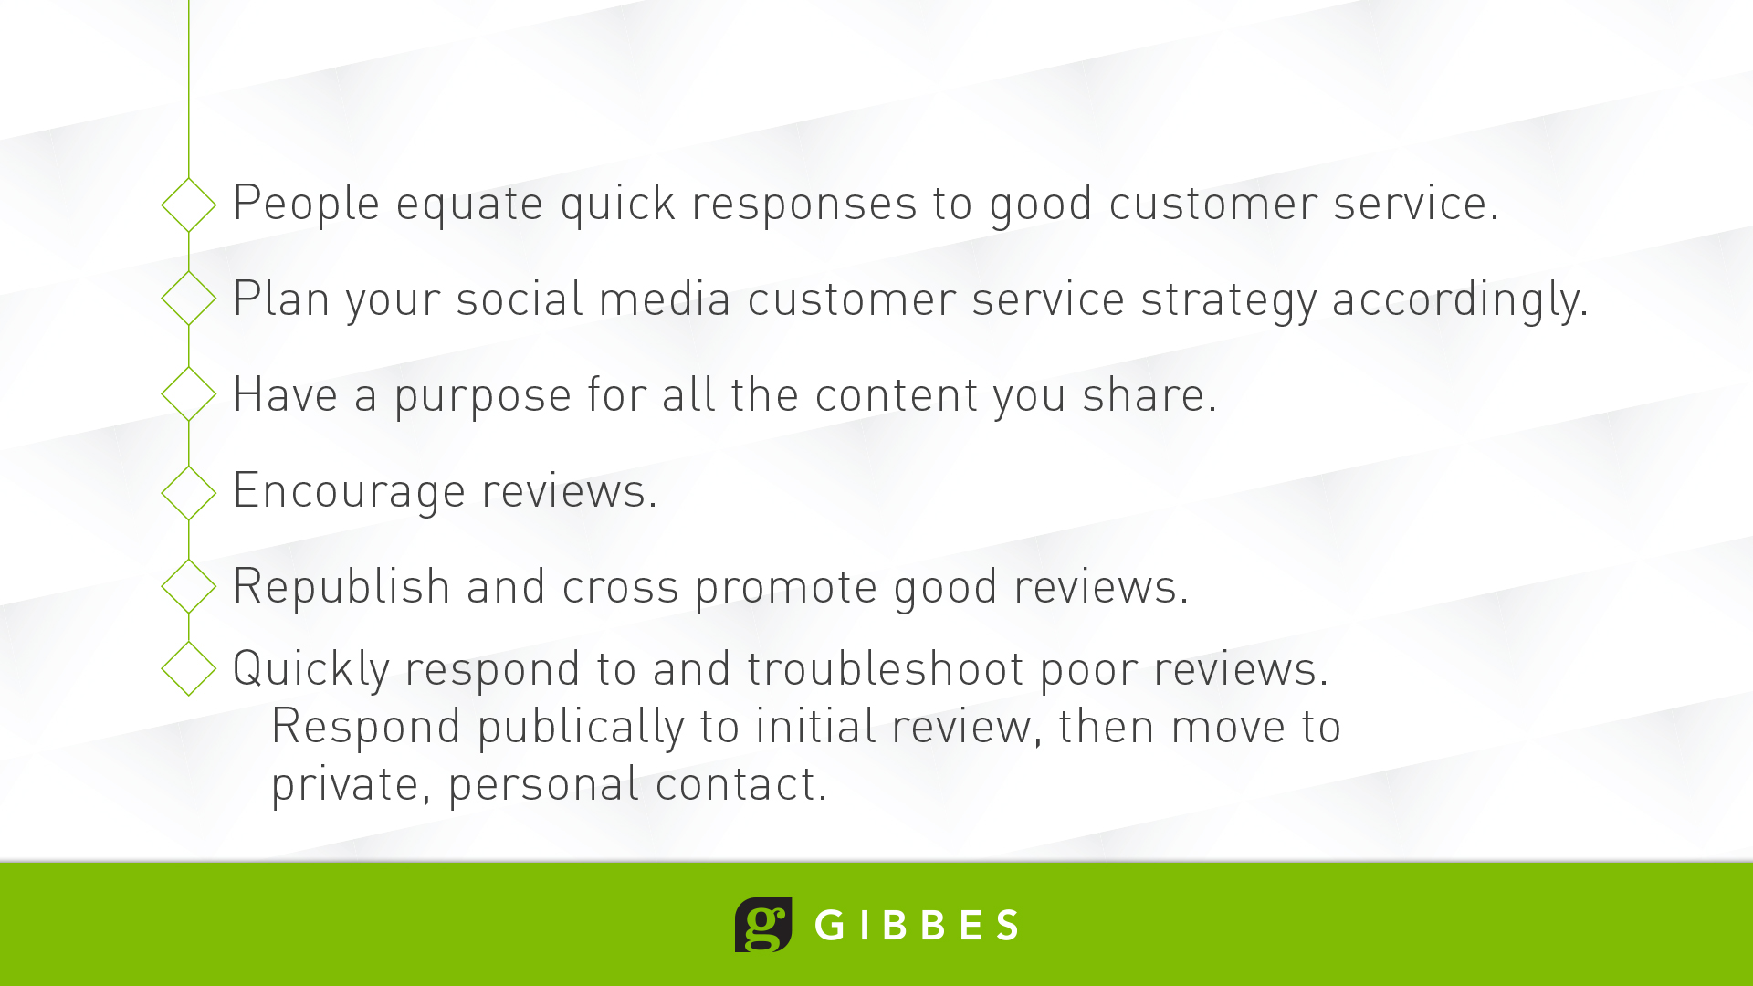
Notes:
I look at Twitter like I do the scrolling news feed at the bottom of my TV.
As with Facebook you have advertising alternatives – sponsored posts, web cards, website conversions, etc. I find Twitter’s advertising support to be more effective, but the end results pale in comparison to Facebook.
Use this more to establish legitimacy, credibility and newsworthiness. News outlets get their stories from Twitter.
As with Facebook, tag interested parties, partners and officials. Generate more views and interest.

Slide 19
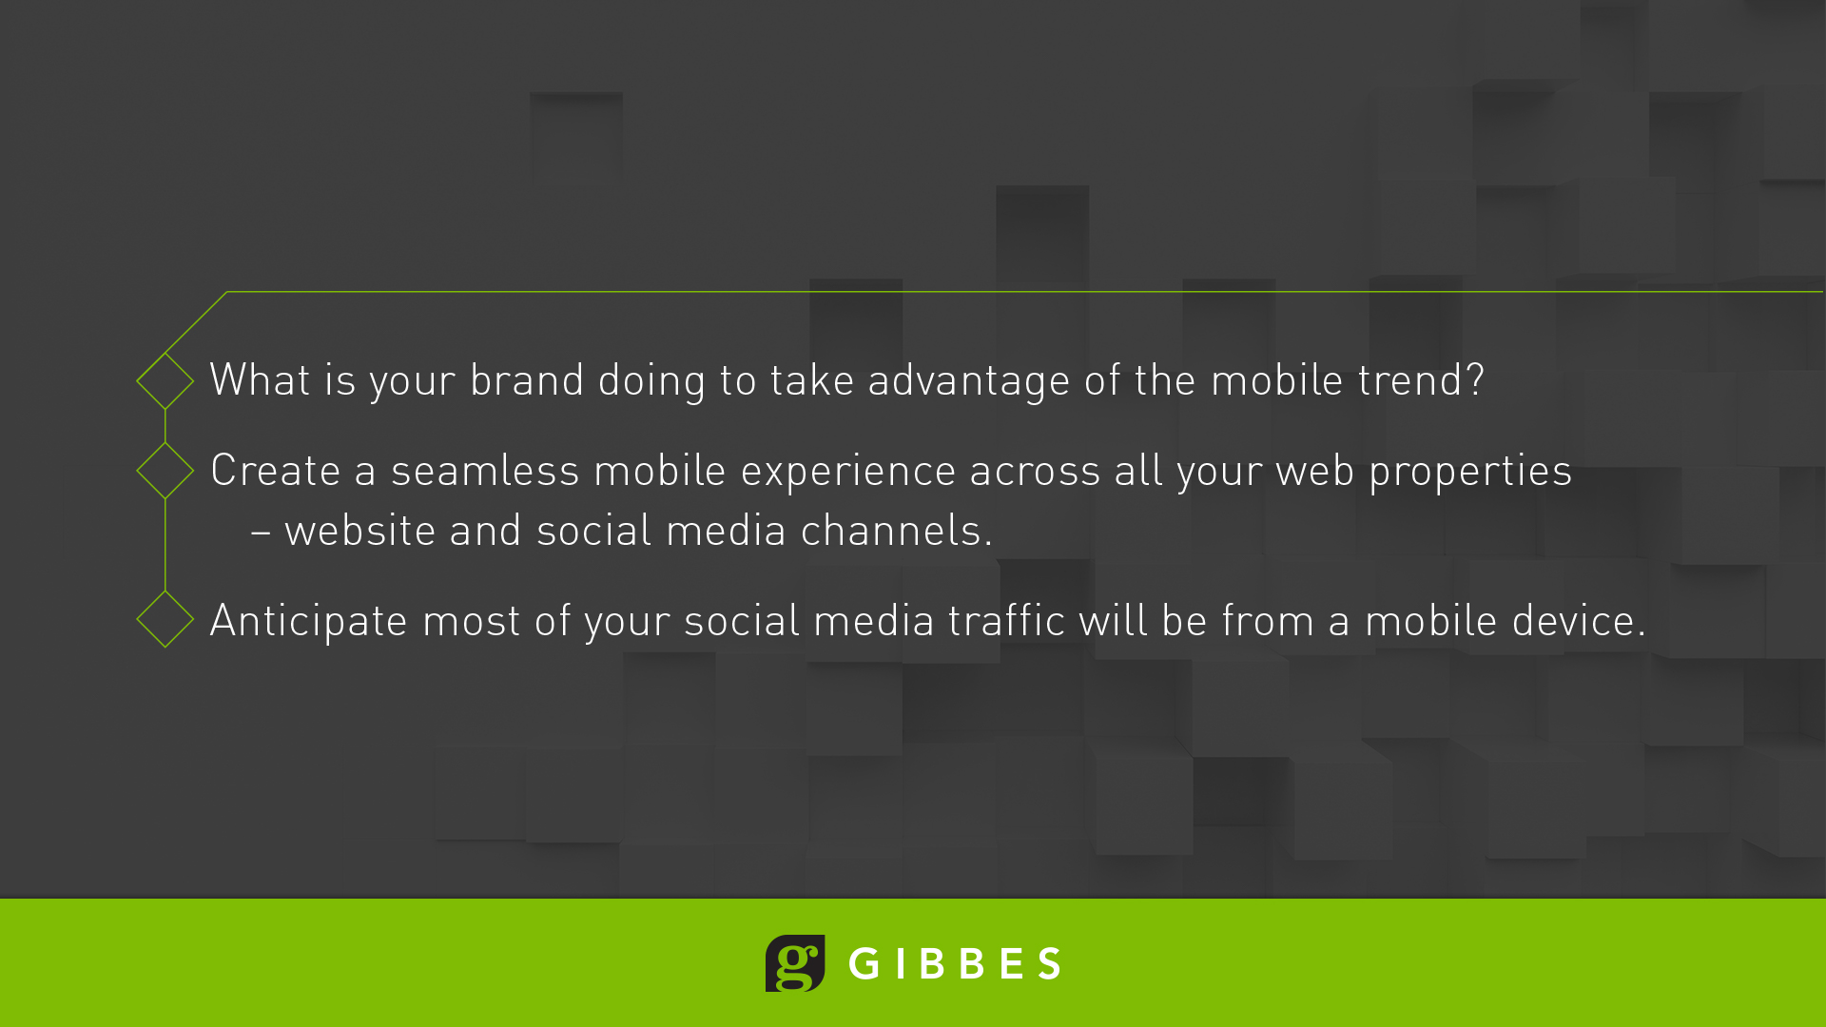
Notes:
Video of the pool.
Mention Boomerang.
20% of Facebook Videos are Live Streams

Slide 20
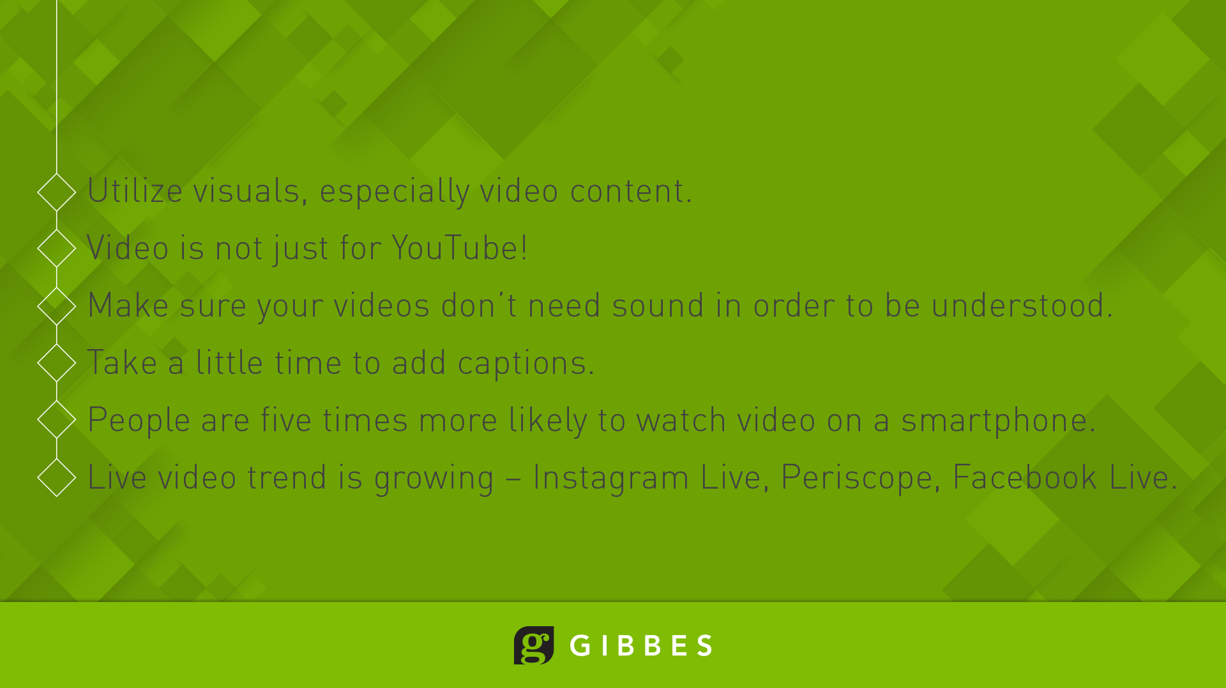

Slide 21
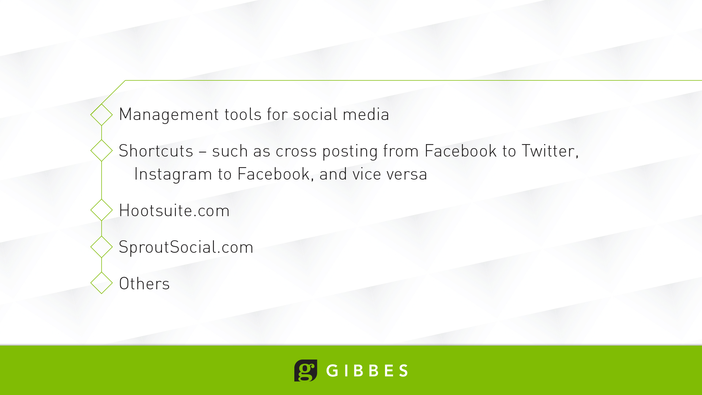
Notes:
Engineers must be at the forefront of innovation and emerging technologies as well as the new technologies that have become important tools for engineers and designers.

Slide 22

Notes:
Email – eblast newsletters – may be the simplest tool in your social media toolbox.
Most people are more comfortable sending (and receiving) emails.
Almost everyone has access/has an email address.
Are you capturing your customers’ information?
Are you marketing to your existing customers?
Are you using your existing customers to promote your brand?

Slide 23
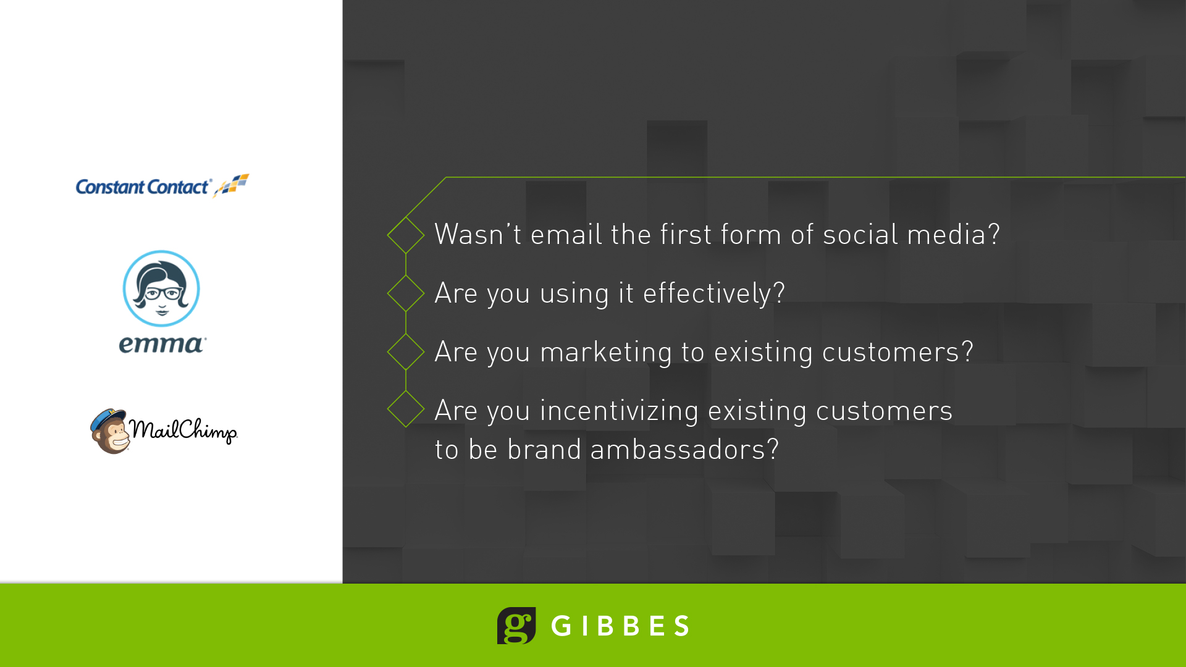

Slide 24
