Slide 1
Why Do I Need a CPA?

Slide 2
How a CPA Can Help:
IRS and Other Government Regulations
Local, State, and Federal
Business Setup
Legal and How to be Taxed
Application to Pay Taxes – What taxes do I pay?
Sales Tax, Withholding Tax, 941 Taxes, Unemployment
How do I get paid?
Salary, Owner Draw, Partnerships
Business and Personal Tax Returns

Slide 3
How a CPA Can Help:
Avoiding Penalties and Interest
The importance of setting up proper records
Reporting to your bank
Understanding the numbers
How to treat the business as an investment – not just a job.

Slide 4
IRS and Other Government Regulations: Don’t Be Afraid of the IRS
Federal Regulations Internal Revenue Service (IRS):
Is this a business?
Intent should be to make a profit
Can take losses against ordinary income
Deductions limited with a hobby
Must report all income regardless
Need to select a business structure
Sole Proprietorship (Schedule C)
Partnership (1065)
C Corporation (1120)
S Corporation (1120S)
Limited Liability Company (LLC)

Slide 5
IRS and Other Government Regulations: Don’t Be Afraid of the IRS
Personal liability protection
No protection for Sole proprietorship and General Partners
LLCs and Corporations are protected
Self employment taxes
Employer share of social security and medicare
Benefits of S-Corp
Employer Identification Number (SS4 form)
Choosing a tax year
Calendar vs. Fiscal Year
Tax deadline – 15th day of the fourth month.

Slide 6
IRS and Other Government Regulations: Don’t Be Afraid of the IRS
State Requirements
Articles of organization or incorporation
Name, contact info, registered agent, etc…
Annual report – any changes in contact info from year to year
Foreign entity
Sole prop and partnerships do not have to register with state.
Local Requirements
Sales taxes
Privilege license
References
IRS.gov
Publication 15 (Circular E) Employer’s Tax Guide
MS Secretary of State

Slide 7
Business Setup:
Legal Summary – Review Chart
Sole Proprietorship
Partnership
Limited Liability Company (LLC)
Corporation (C-Corp or S-Corp)
Taxation – How do I want to be taxed?
Self employment taxes
Ownership
Double Taxation

Slide 8
Application to Pay Taxes What Taxes do I Pay?
Federal
941 Taxes (federal withholding, social security, medicare)
Federal unemployment taxes (940)
Income Taxes
State
Withholding taxes (TAP)
Sales taxes (TAP)
State unemployment (MDES)
Income taxes

Slide 9
How Do I Get Paid?
Owner’s Draw
Regular intervals or as needed
Non-deductible expenses – reduce equity
Pass through entities
LLC, Partnerships, S-Corp
Salary (W2)
S-Corp reasonable salary
C-Corp double taxation
How to determine how much to pay yourself?
Business Structure
Business Performance
Business Growth
Reasonable Compensation

Slide 10
Business and Personal Tax Returns:
Filed with 1040 personal return
Sole proprietorship
Single Member LLC
Separate Business returns
S-Corp (1120S)
Partnerships (1065)
C-Corp (1120)
Filing Deadlines
Business
Personal
Estimated Taxes – April, June, Sep, Jan

Slide 11
Avoiding Penalties and Interest:
Payroll Taxes Deadlines
Sales Tax Deadline
Estimated Taxes
Extensions (Only to file, Not to pay)
IRS wants their money

Slide 12
The Importance of Proper Records:
Debits and Credits – Do I need to know accounting?
Choosing the proper software
Separate Bank Accounts
Reporting all Income
Categorizing expenses
Using credit cards

Slide 13
Reporting to Your Bank:
Banks need to review financials
Business loans
Asset purchases
Interim financials (monthly, quarterly)
Year End financials
Cash vs. Accrual
Tax Basis
Other accounting framework (GAAP)
May need a Compilation, Review, or an Audit.
Must be performed by CPA

Slide 14
Understanding the Numbers: What Does All This Mean?
Cash and Bank Reconciliations
Cash Flow and Budgeting
Balance Sheet
Assets and Liabilities
Income Statement – Profits
Understanding Margins
Equity
Budget Comparisons

Slide 15
My Sales
Sales Systems
A digital platform that holds key metrics, customer information and other relevant material to help you track and meet sales goals.
Difference between Marketing and Sales
Marketing – expenses to attract customers
Sales – converting those potential customers/leads to payments for your products or services.
Distribution Channel
Path produce/service takes to get to the market.
Direct or Indirect

Slide 16
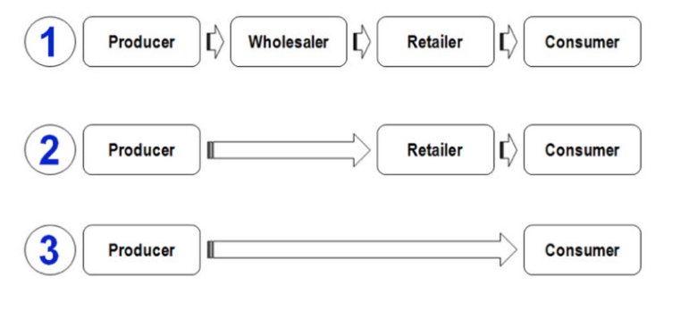
Direct vs Indirect
Direct vs. indirect distribution channels

Slide 17
My Sales
What is the right price for my product or service?
Depends on cost – variable vs fixed costs
Competition
Demand – what does the market allow?
What sales do I need to make a profit?
Need to understand cost – breakeven analysis
Could be based on volume
How do I estimate my sales?
Forecasts and projections
Market analysis - competition
Know your sales price, quantities, costs

Slide 18
Estimating My Expenses
Why is profit important?
Growth, Market fluctuations, Prepare for the unknown
Secure financing from bank
Attract investors
Direct Cost vs Indirect Costs
Direct – COGS (labor, materials, supplies)
Indirect – Rent, utilities, general office expenses
How long will it be before I make a profit?
Startup cost
Marketing – customer base
Sales Volume

Slide 19
Estimating My Expenses
What is cash flow?
A measure of how much cash a business brought in or spent in total over a period of time – cash in vs. cash out.
Operating activities – daily operations
Investing activities – investments in other companies, stocks, etc..
Financing activities – raising money by selling bonds, paying money through dividends or stock buybacks.
How do I plan for cash flow needs?
Understand your costs – budget of expenses
Sales forecasting
Prepare for the unexpected

Slide 20
A Business Should be an Investment:
Forecasting and Strategy
Set Goals
Understanding Trends
What do the customers want?
Learn to adapt
Planning for the unexpected
Pandemic for an example
Importance of an Emergency Fund
Don’t burn through all your equity
Have a plan and always be prepared
Partner with a CPA and utilize their knowledge

Slide 21
Thank You
Clint Brown, CPA
Brown CPA PLLC
7708 Old Canton Rd, Suite A
Madison, MS 39110
Office: 601-879-4411
Cell: 601-325-6013
clint.brown@brownafs.com

